Slide 1
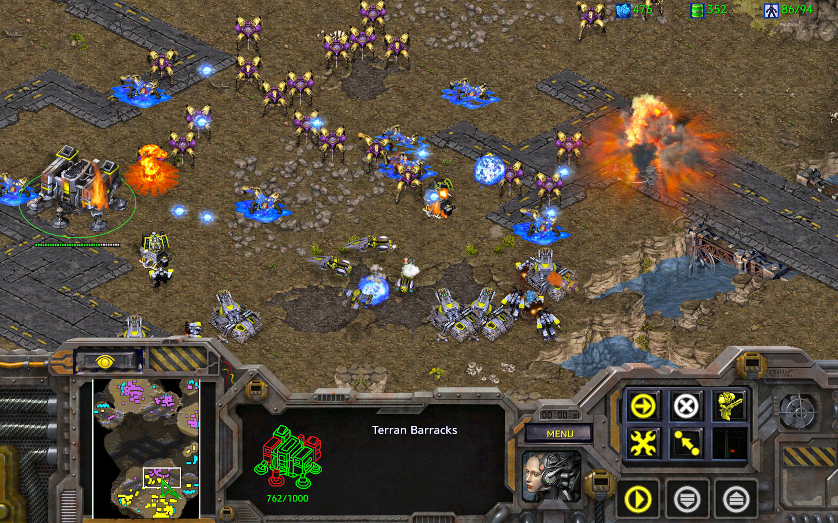


Web-base Interface for Data Labeling in StarCraft
- StarCraft Visualizer -
S
Inchang Baek, Kyung-Joong Kim
Cognition & Intelligence Laboratory
Sejong University, South Korea
bic4907@gmail.com, kimkj@sejong.ac.kr
Sejong
CILab

Slide 2
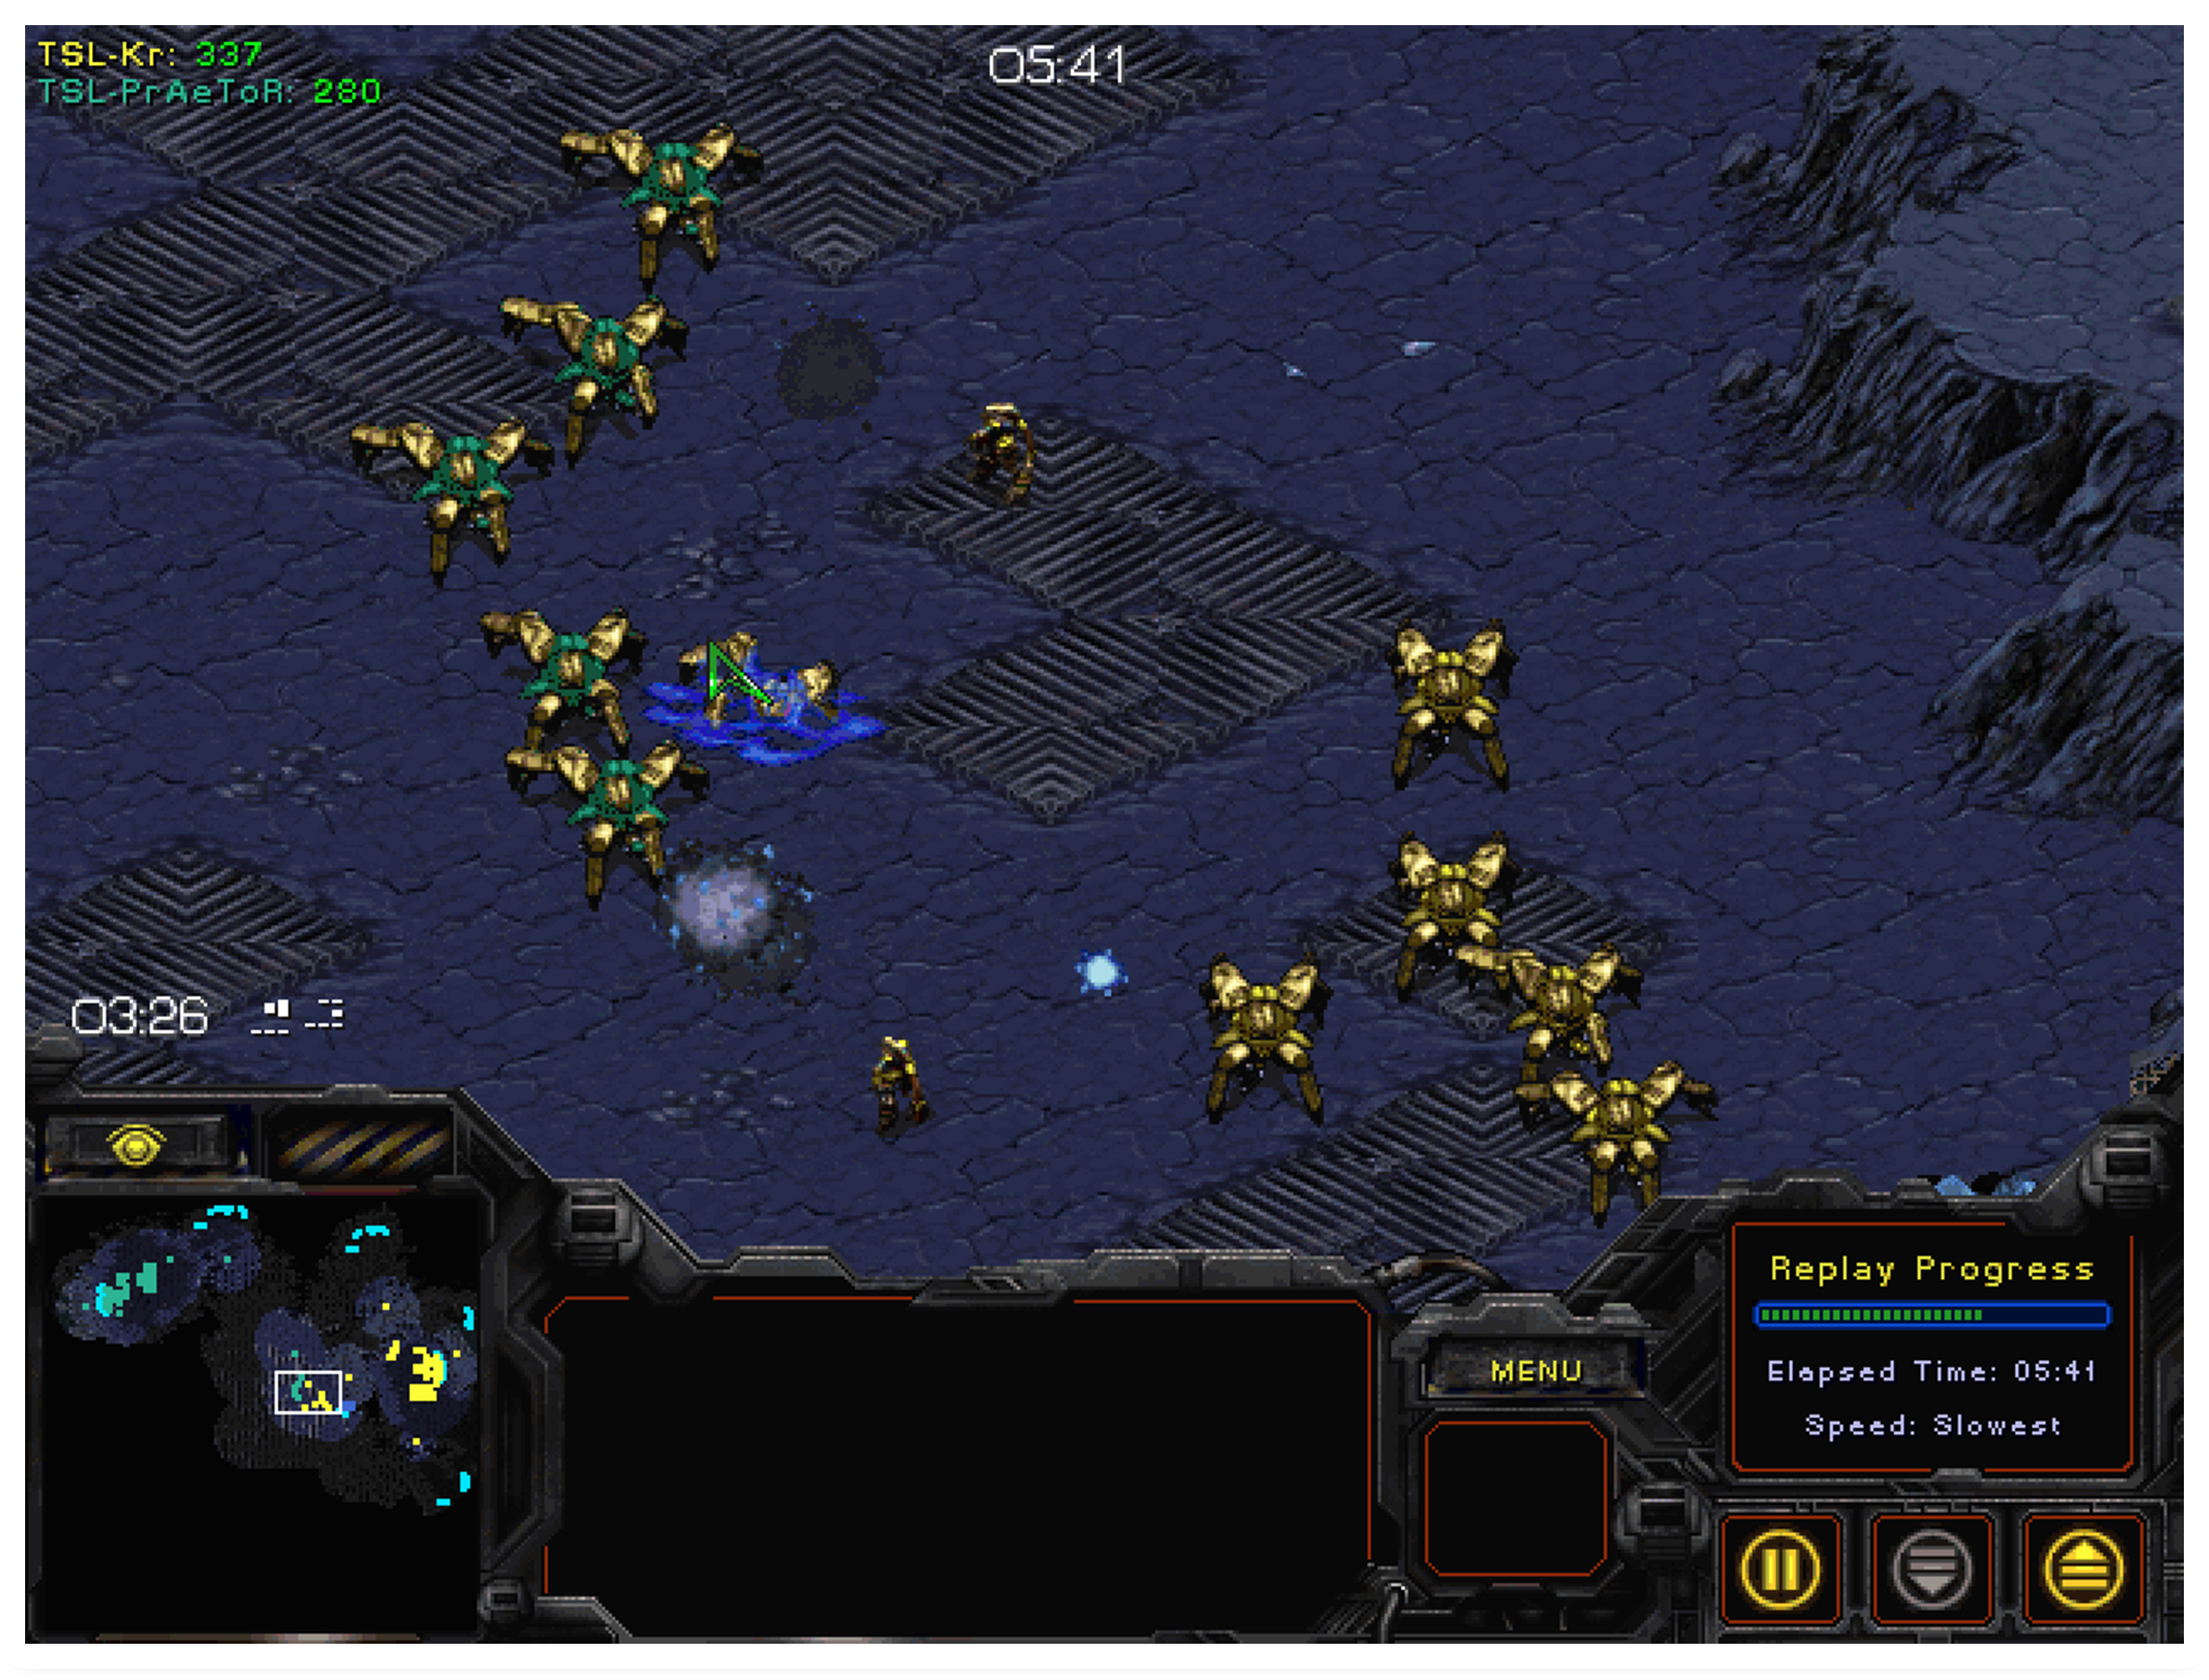
Old Environment
StarCraft Game Interface
limited visibility
Cannot Rewind
Unmarkable
Notes:
This is StarCraft game screen.
First, it has limited visibility so we can’t understand the context of the game at a glance.
Second, it also have replay mode but doesn’t support rewind.
Also, we can’t mark on the game screen, so it is not suitable for data collection.

Slide 3
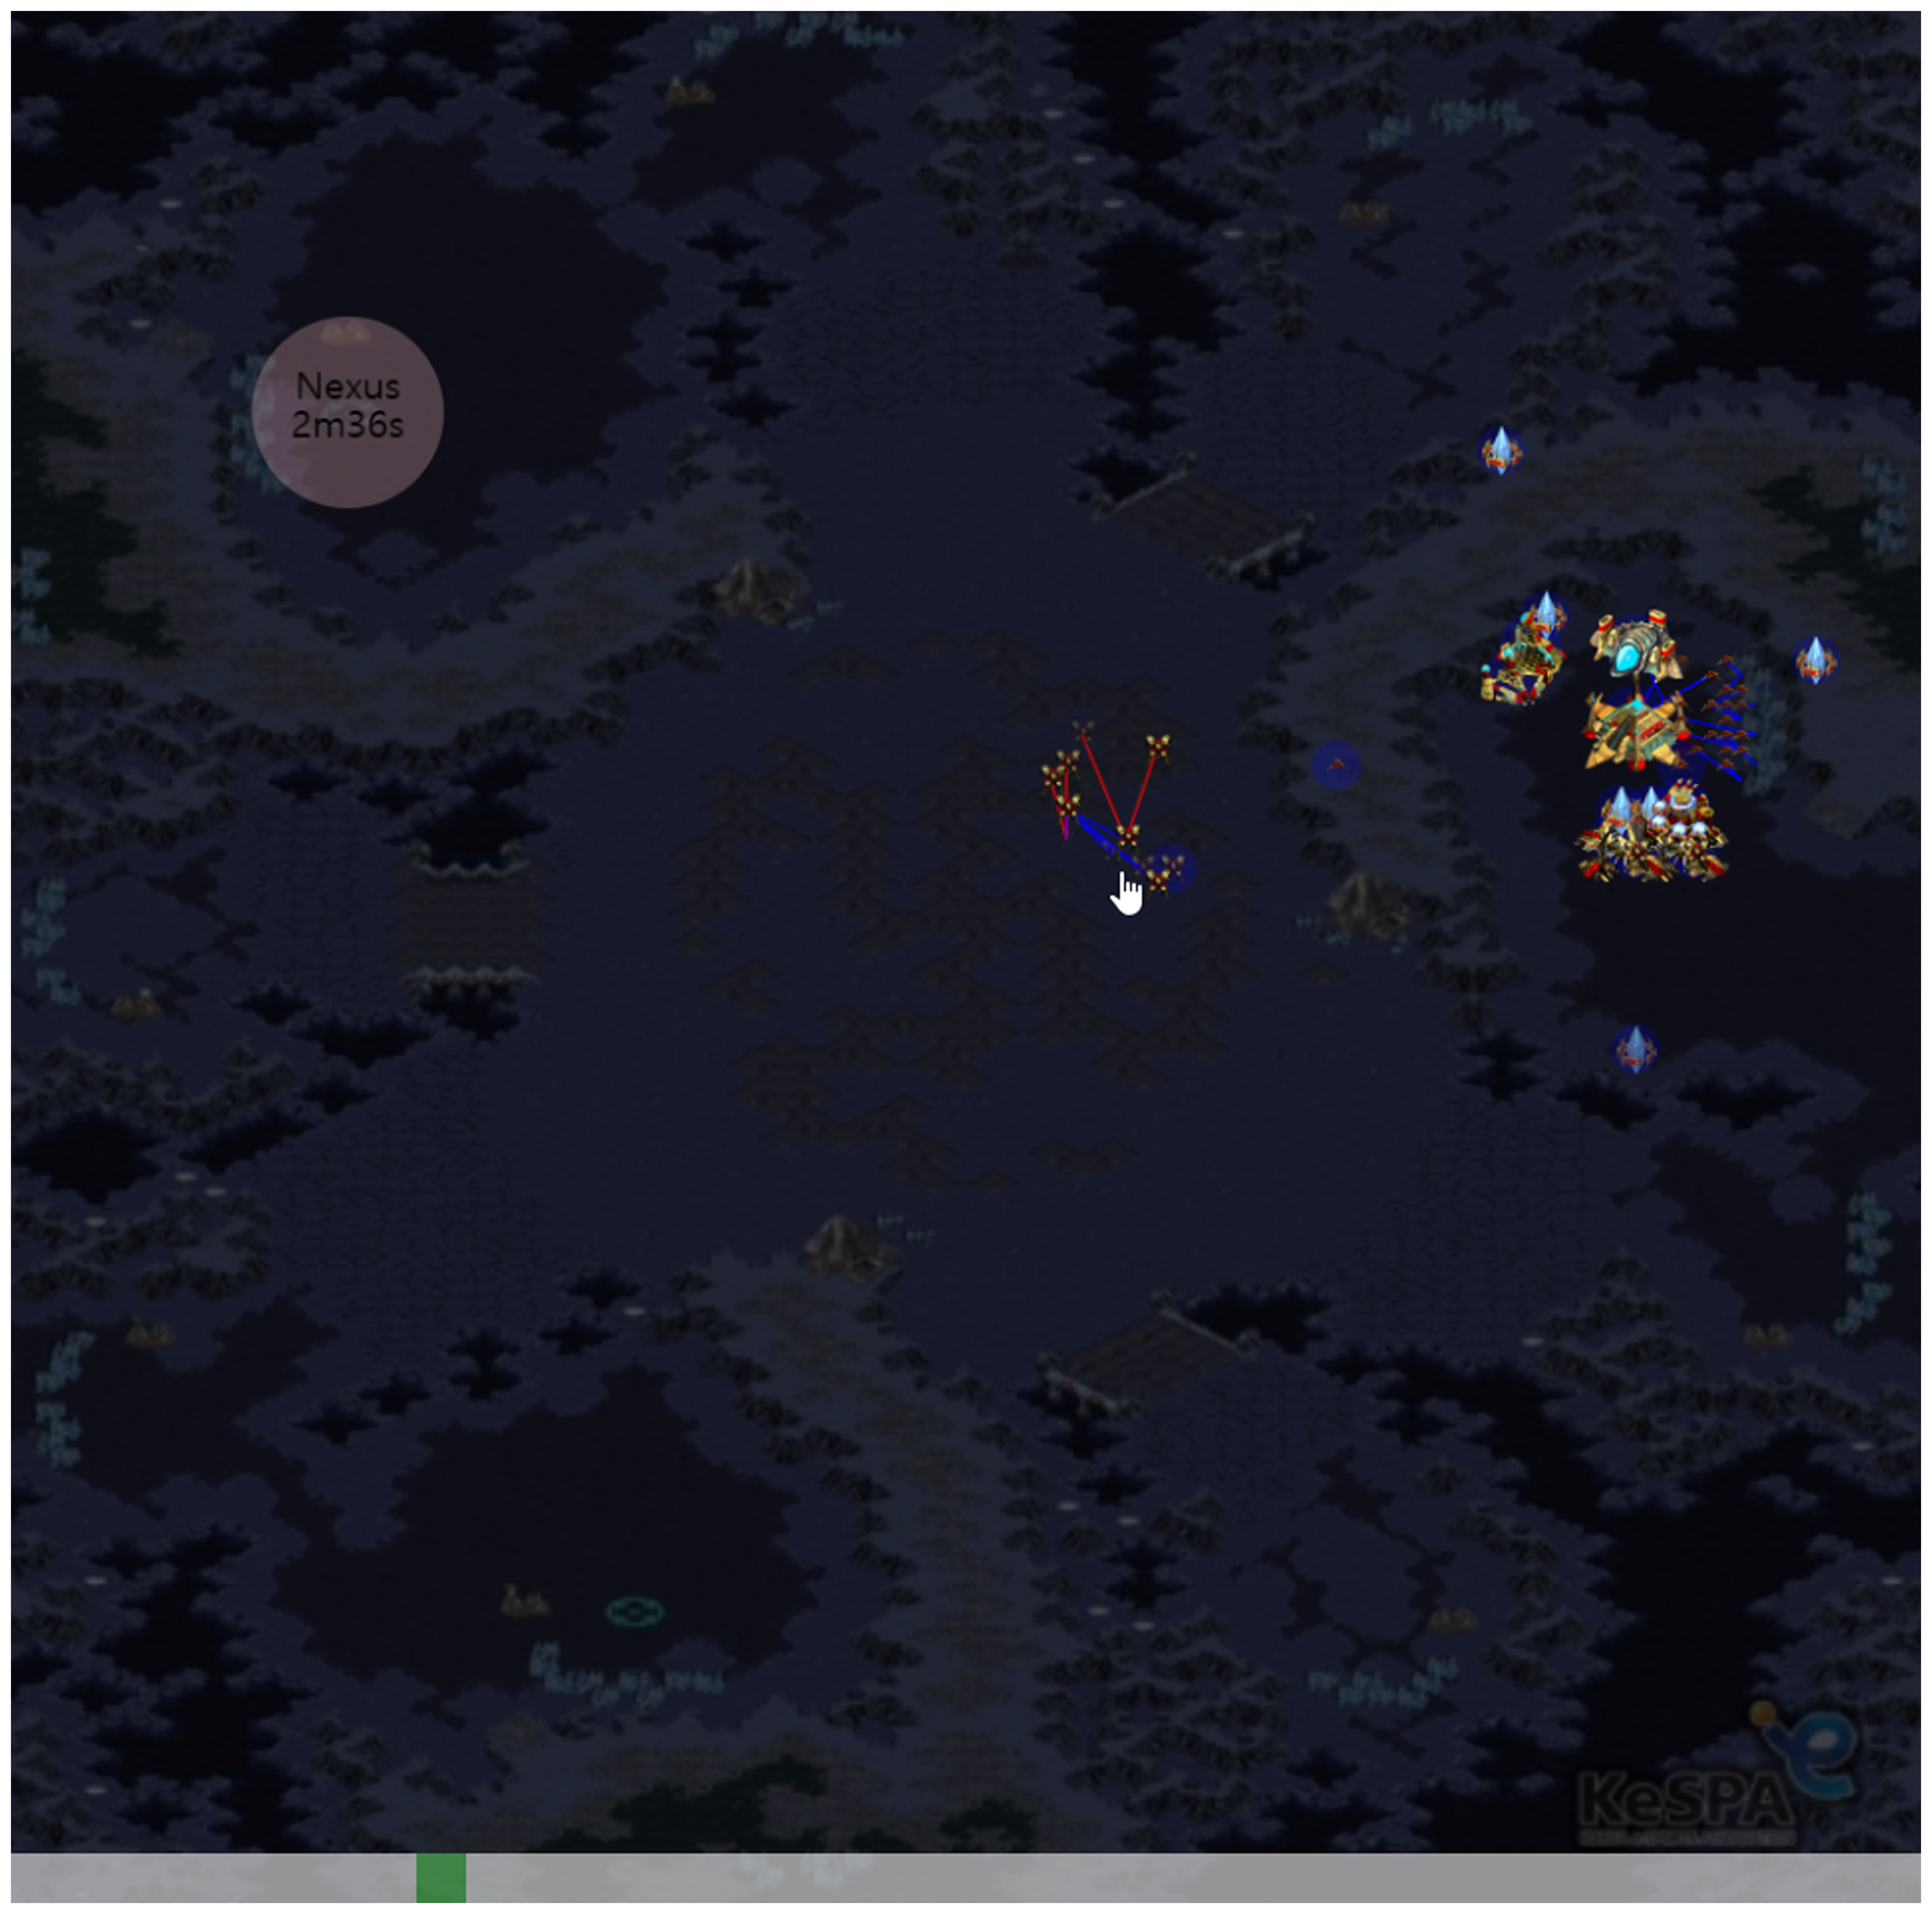
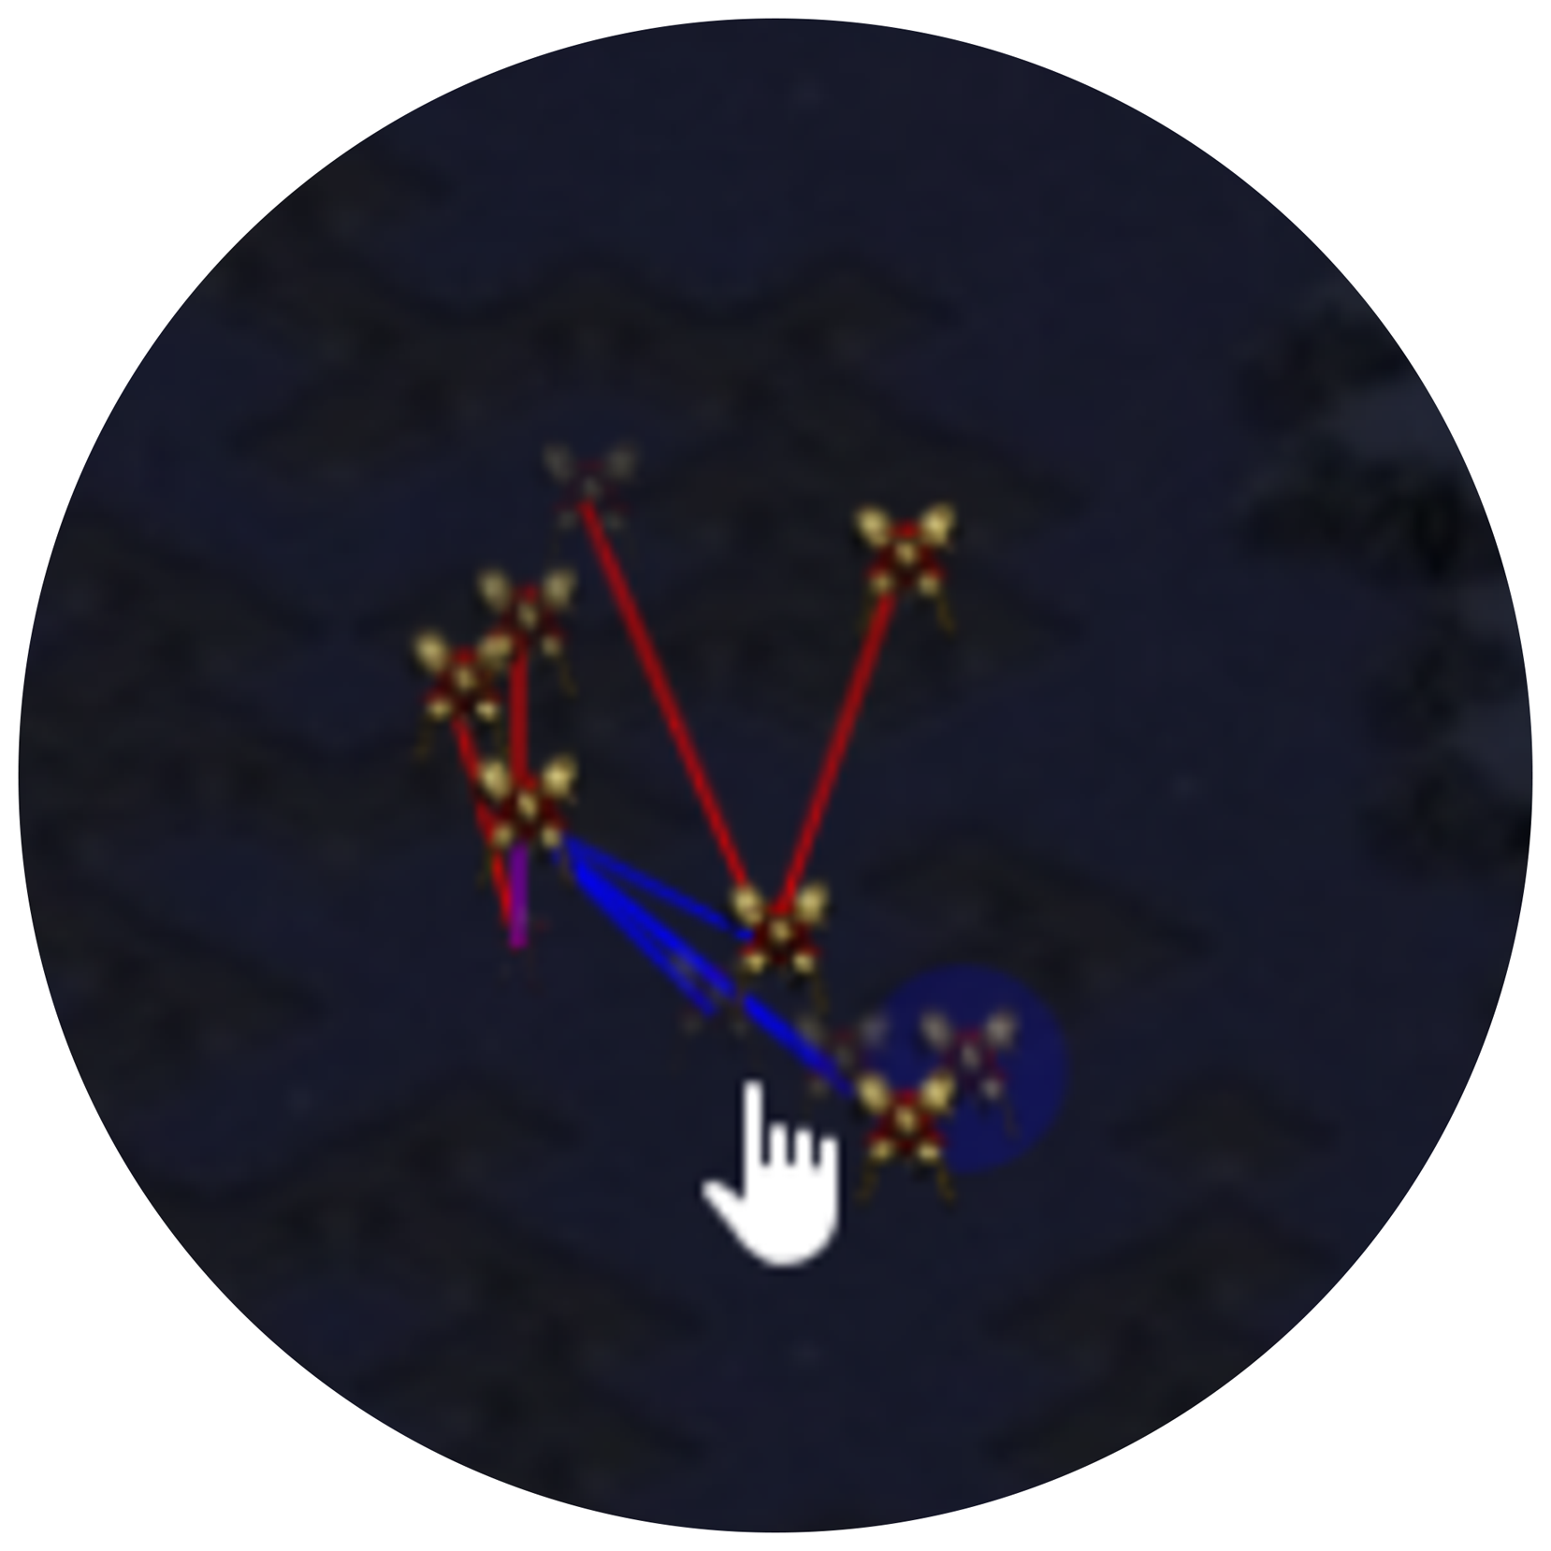
New Environment
Proposed Interface
Full-game screen
Video (Fast-forward, Rewind)
Colorization
Connected with Q&A Server
Notes:
And this is my proposed method.
It supports full-game screen, so we can see where are buildings and units.
We can distinguish between enemy and ally units via color. Red means ally units, and blue indicates ally units.
It is difficult to judge a situation with single screen, so we made a video function.
The video function continuously displays the game screen like a video.
That, we can understand the context quicker and easier.
And this environment is connected with a server, you can get question and send answer in real-time.

Slide 4
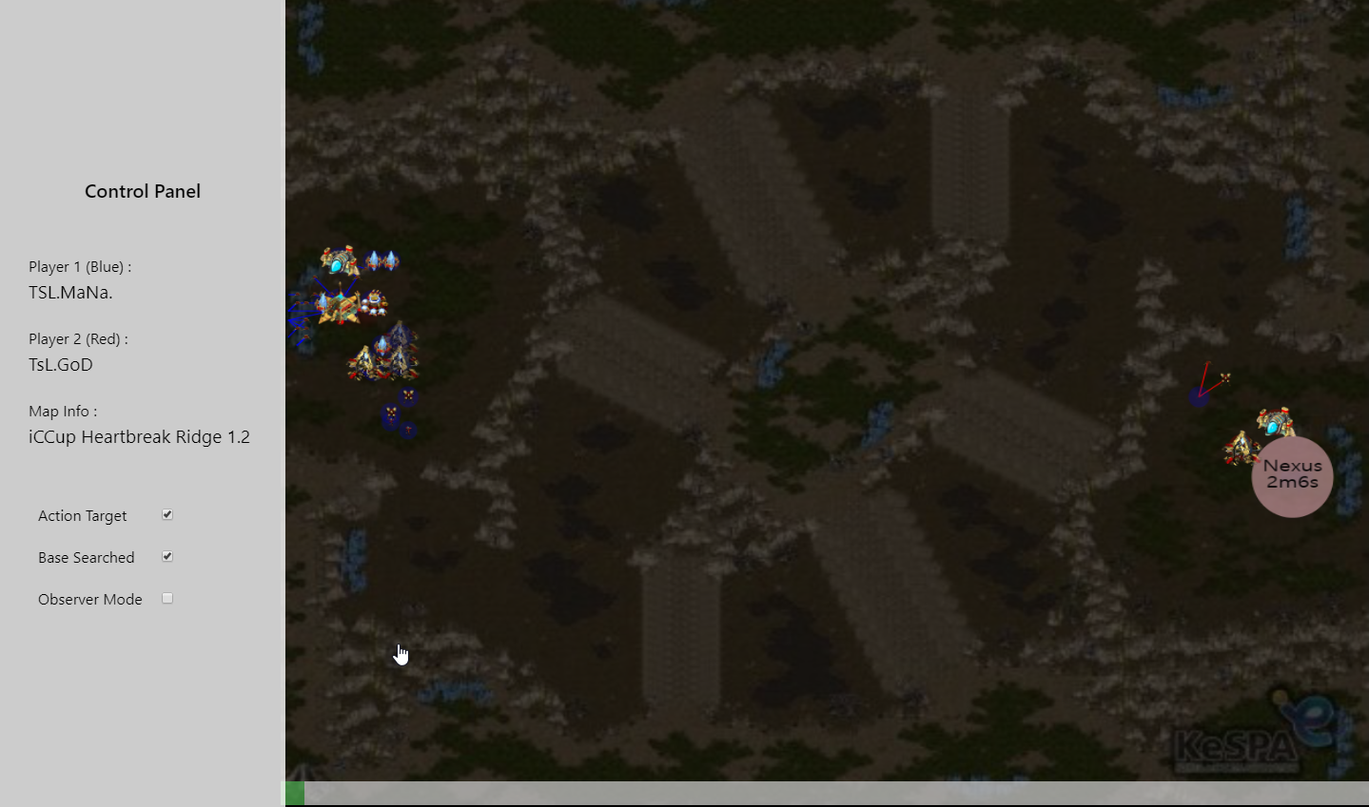
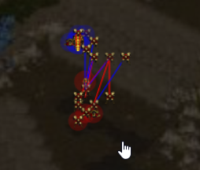
Manual(Interface)
Game Info
History of discovery of base
Target of Unit’s Action
(Gather, Attack)
Display both of ally&enemy
Notes:
This is the interface of the environment.
It has control panel on the left and you can get information about a replay.
Also, you can toggle some options for a tester.
With first option, you can know what are units doing like gathering and attacking.
With second option, you can get discovery history of enemy’s base.
And final option is displaying both ally and enemy together.

Slide 5
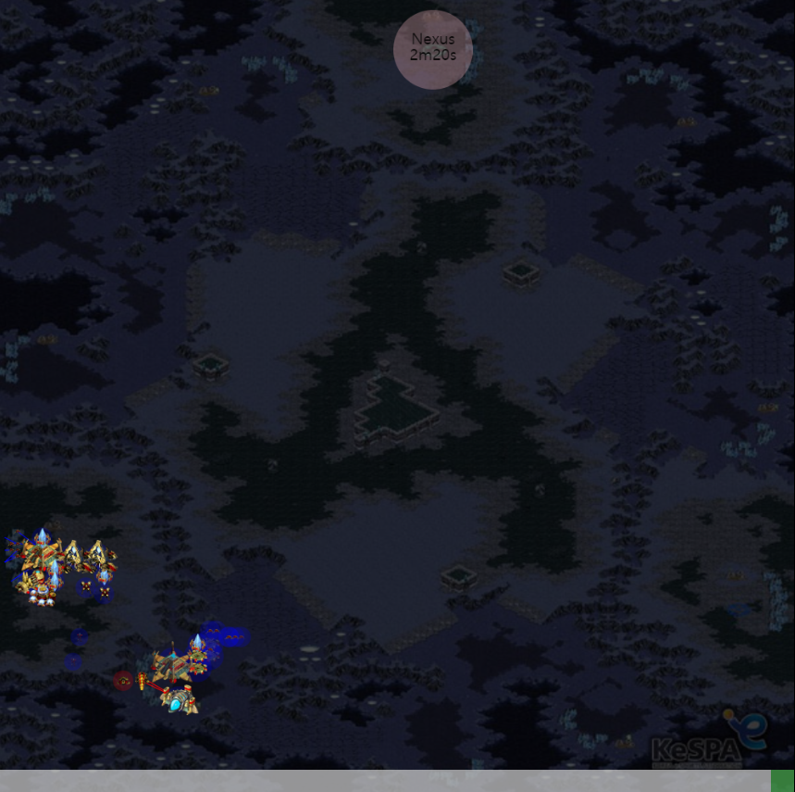
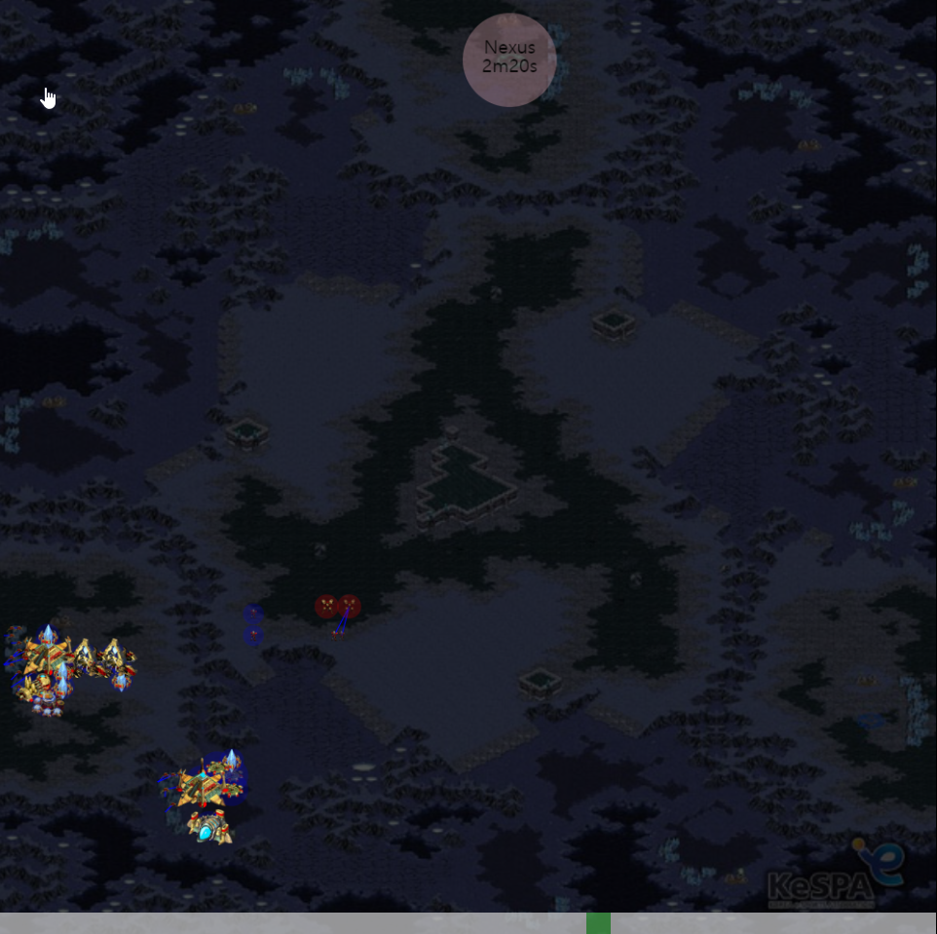
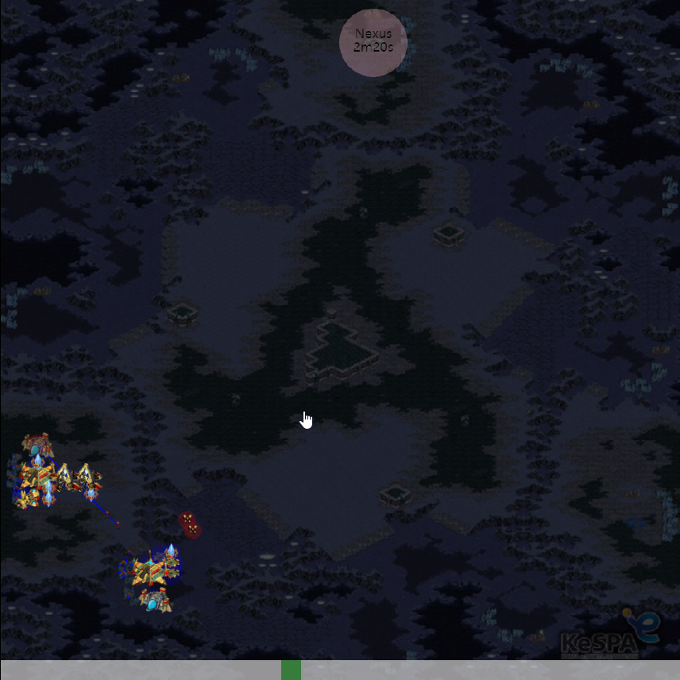
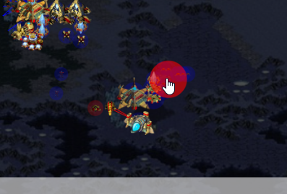
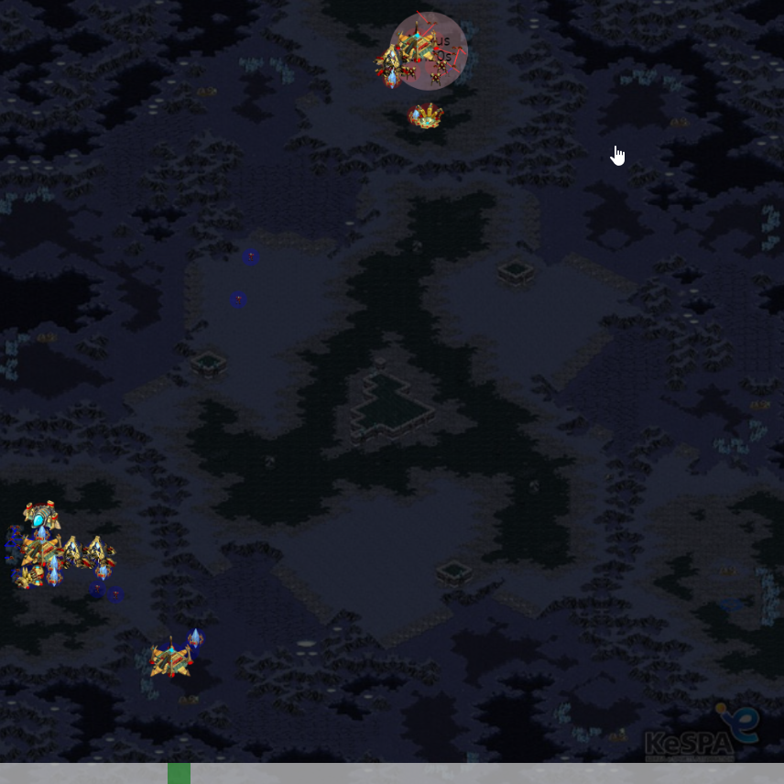
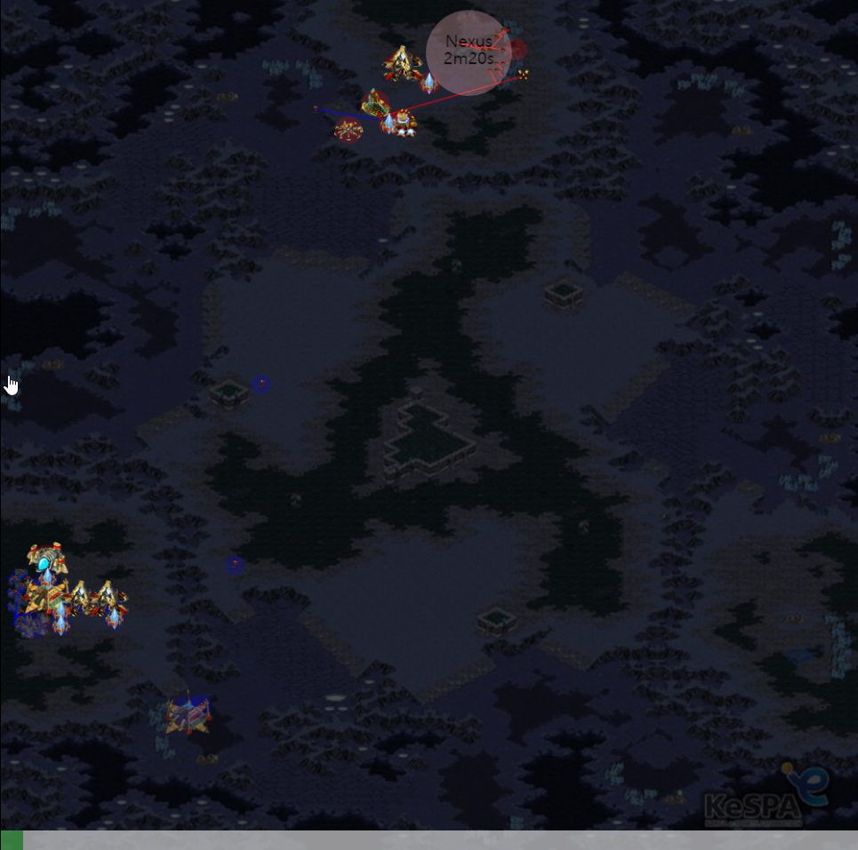
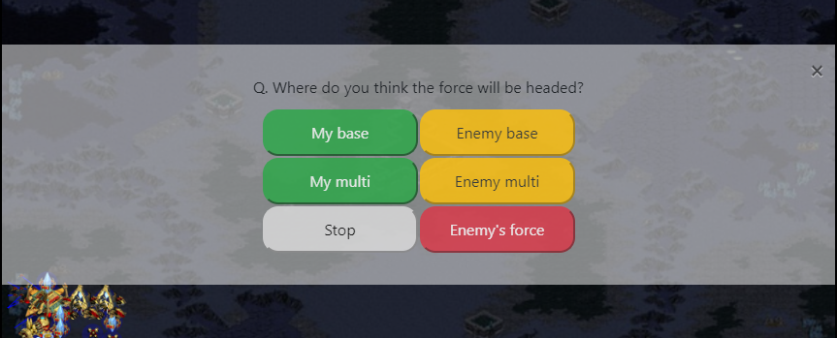
Manual(Labeling)
Step 1.
Step 2.
Step 3.
Understand the context of game with video function!
(keyboard arrow key supported)
Click on image where is the main force
Answer to the extra question
Notes:
This is labeling task order.
First, you can understand the context of game with video function.
For tip, keyboard arrow keys are supported.
At the final scene, you can click on the image for where is the main force.
Finally, answer to the extra question that where the main force will be going to.
The answer will be send to the QnA server and next question will be sended.

Slide 6




Usage
Real-Time AI Debugger
Evaluating performance of AI model
Adaptive for other games
Understand context of game and AI’s prediction at a glance.
We can see where it is vulnerable.
The system can be replaced by another game only by replacing to the game structure and image resources.
Performance of AI model can be measured based on labeled data.
Notes:
This is the usage.
First, Environment like this can be use to Real-Time AI Debugger.
This environment project full game screen, so we see the game screen and AI’s prediction at a glance.
So it is easier to know when AI makes the wrong predictions.
Second, labeled data from this environment is useful to evaluating the performance of AI models.
If you change the question, it can be use for various AI models.
Third, this system can be adaptive for other games like warcraft and starcraft2.
If you want, you can change the structure and resource of the environment for other games.

